Slide 1
Reminders...
You’ll use this file for the entirety of this capstone. Save it in a place where you can easily access it over the upcoming weeks.
You can edit and save this document in Google Drive
If you download this document, keep it in a place you can find it later
The content you put into this document will be used later
It is recommended that you do not skip any capstone readings
Feel free to customize this slide deck to make it your own, but make sure to answer all the questions in the prompts
Requirements:
Answer all the questions in this document
When complete, download this as a PDF document for submission in the peer review assignment.
Don’t know how to download as a PDF? You can find more information about downloading this by clicking here.
Remove this slide before submitting

Slide 2
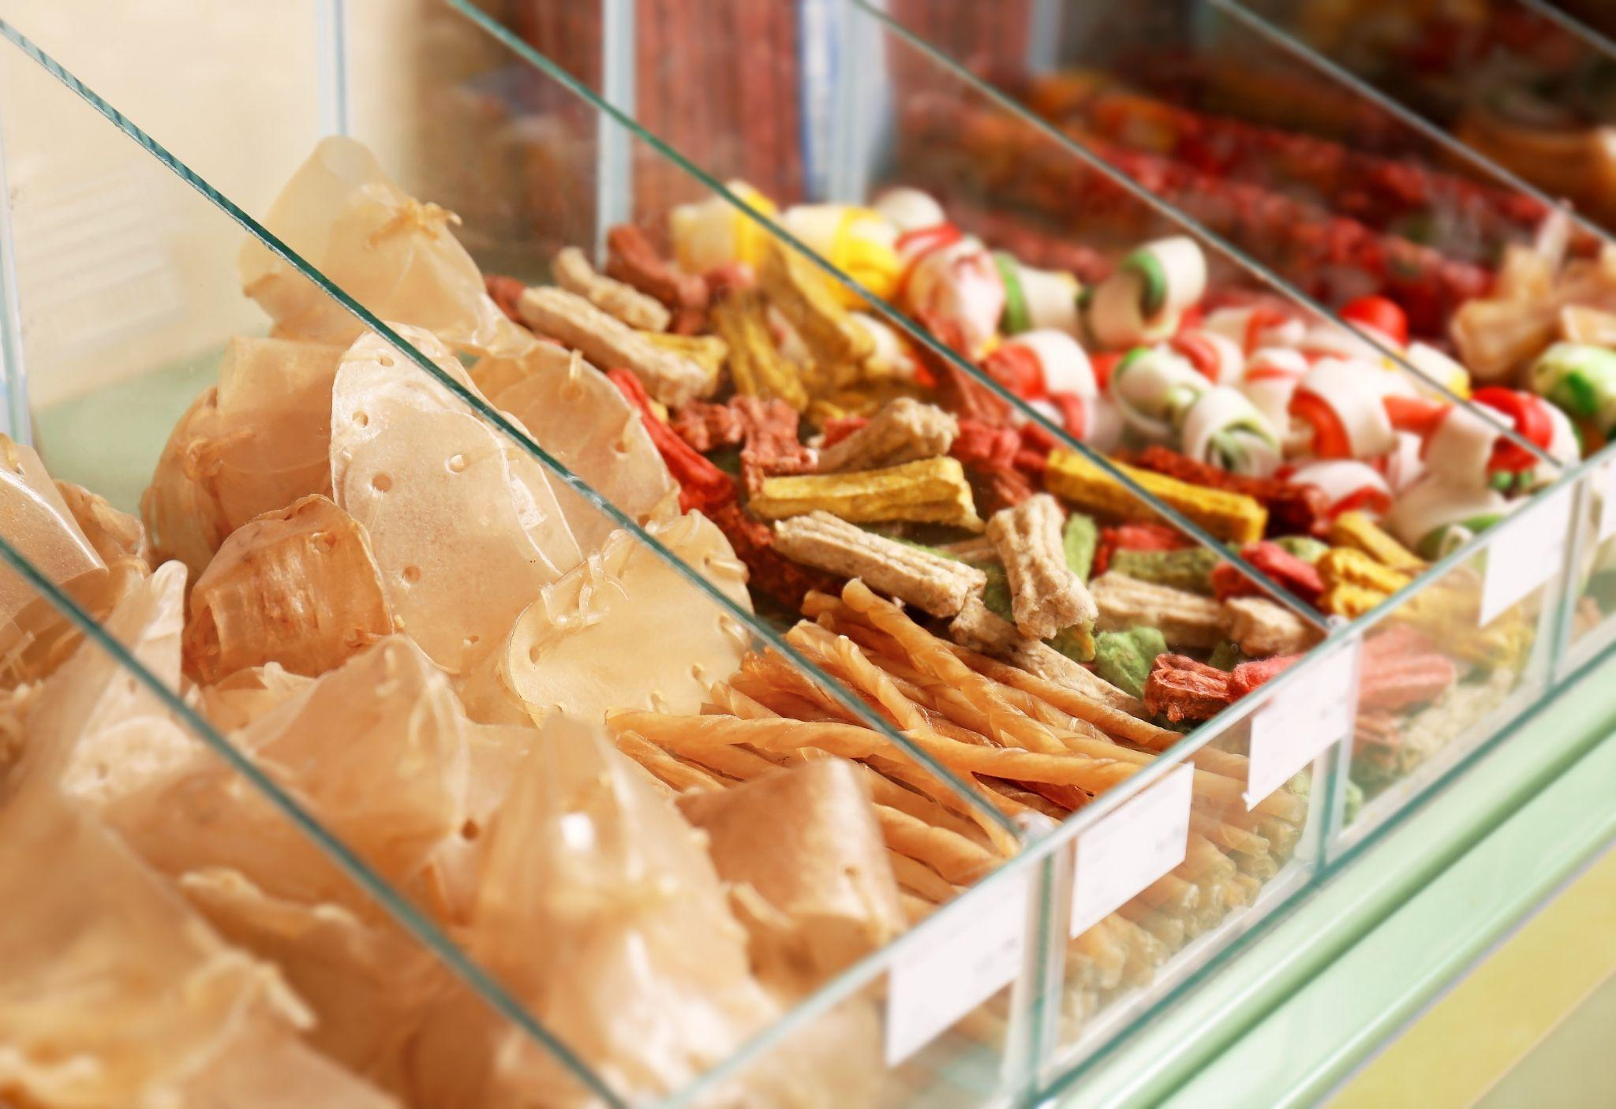







Images from Inu + Neko
Here are a few images that can be used throughout your deck that are part of the Inu + Neko image library.

Slide 3

Course 2 Capstone
The OSEMN Process

Slide 4
Your Approach 1 of 4
Give at least two example questions you would want to answer as an analyst that relates to Inu + Neko’s business problem.
Remember a good question includes a focus on something that is actionable and follows the SMART goal principles (specific, measurable, attainable, relevant, & timely).
What are purchases trend by month and days?
What are purchases made by title and categories?
What are the purchases quantities by ages?
What are total sales monthly and by categories?

Slide 5
Your Approach 2 of 4
What information do you think would be particularly important to your analysis for Inu + Neko?
Dates (trans_month and trans_day)
Cust_age
Trans_quantity
Prod_title and Prod_category
Total_sales

Slide 6
Your Approach 3 of 4
How would you go about gathering this information?
Look for first hand sources from Inu + Neko past purchases for last few years (2017-2020)
Liaise with other similar parties that have second hand sources for these data
Source from website or buy data if there is a possibility

Slide 7
Your Approach 4 of 4
What are some potential issues or roadblocks can you see in trying to get this information to address Inu + Neko’s business problem?
Legal and privacy issues of customer data
Data may be incomplete or missing
Potential of biases in data
Data entry mistakes
Data trustworthiness

Slide 8
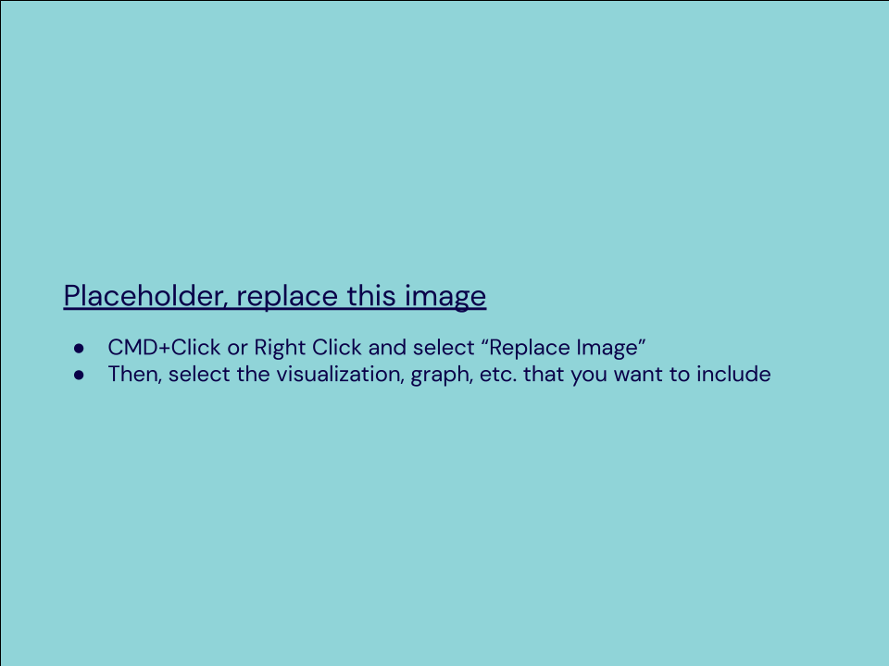
Your Data Visualization
Using Tableau, create the requested visualization (Placeholder)

Slide 9
Your Data Visualization
Using Tableau, create the requested visualization (Placeholder)

Slide 10
Your Data Visualization
Using Tableau, create the requested visualization (Placeholder)

Slide 11
Your Data Visualization
Using Tableau, create the requested visualization (Placeholder)

Slide 12
Your Visualization Interpretation 1 of 2
What does this visualization show about the data?
Enter your answer here:

Slide 13
Your Visualization Interpretation 2 of 2
Does this visualization align with what we’ve seen so far from the data?
Enter your answer here:

Slide 14
Recommendations Based on Model Results 1 of 2
What recommendations would you give Inu + Neko based on the model results?
Enter your answer here:

Slide 15
Recommendations Based on Model Results 2 of 2
What recommendations would you give Inu + Neko based on the model results?
Enter your answer here:

Slide 16
Your Final Insights 1 of 4
What can you say about the current state of the business?
Enter your answer here:

Slide 17
Your Final Insights 2 of 4
What projections can you make about the future state of the business?
Enter your answer here:

Slide 18
Your Final Insights 3 of 4
What would you recommend to Inu + Neko?
Enter your answer here:

Slide 19
Your Final Insights 4 of 4
What more work could be done to expand on your analysis?
(You won’t need to do this but state what would be good next steps for a follow-up analysis.)
Enter your answer here:

